Slide 1


Hope to Skills
Lecture# 22
Irfan Malik, Dr. Sheraz Naseer

Slide 2
Agenda
Recap
Hyper parameters
Learning rate
Epochs
Regularization
Activation functions
Play ground
Quiz

Slide 3
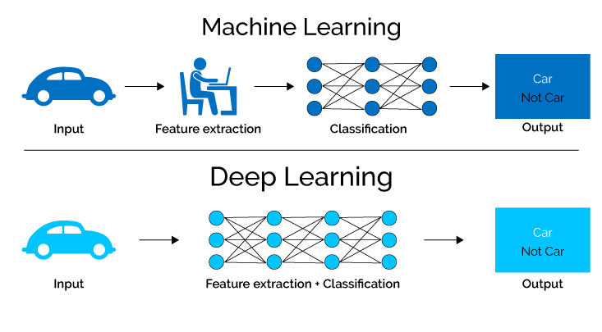
Recap

Slide 4
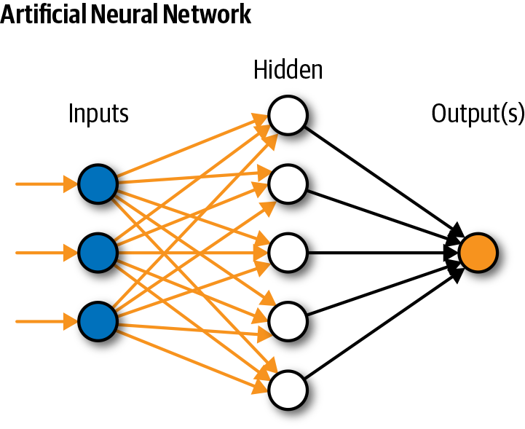
Simple Neural Network

Slide 5
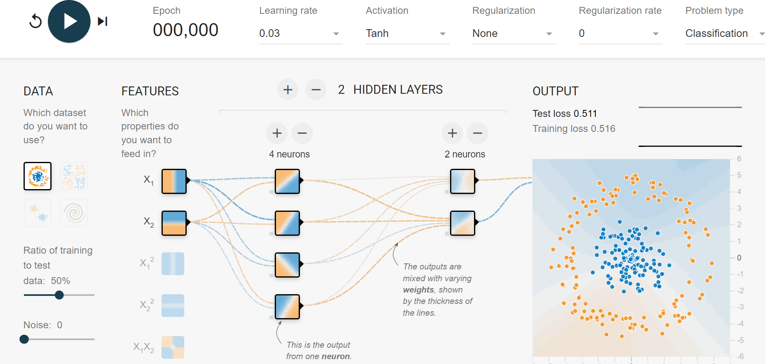
Hyper-parameters

Slide 6
Gradient Descent
A hyperparameter that controls the step size during gradient descent optimization. It determines how quickly the model adjusts its parameters in the direction that reduces the loss.
A higher learning rate might lead to faster convergence but risks overshooting, while a lower rate might slow down convergence.

Slide 7
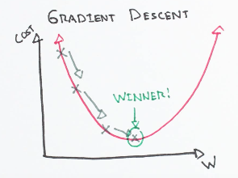
Gradient Descent

Slide 9
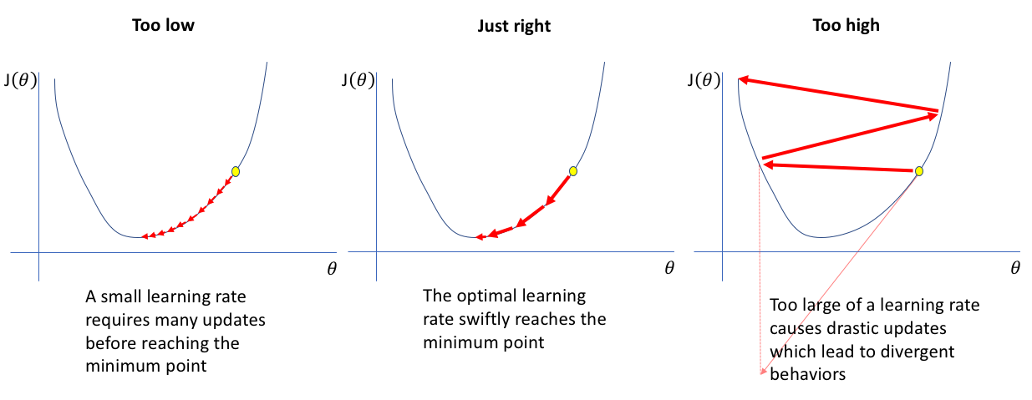
Learning Rate
A higher learning rate might lead to faster convergence but risks overshooting, while a lower rate might slow down convergence.

Slide 10
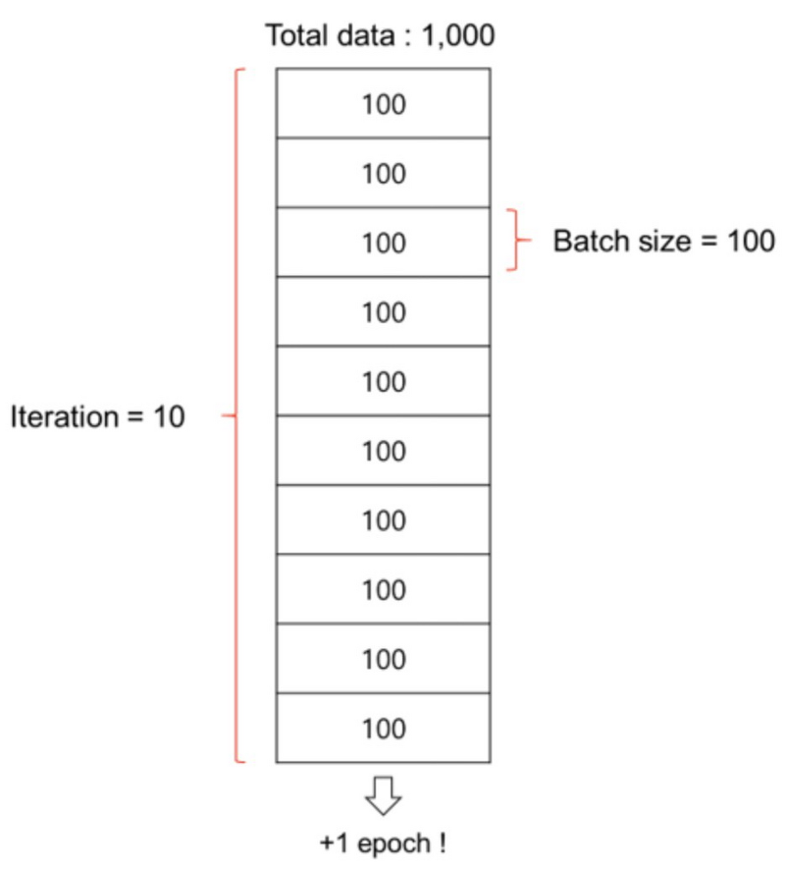
Batch Size
Batch is a subset of the training dataset used in each iteration of the training process.
Instead of processing the entire dataset
at once, we divide it into smaller batches.

Slide 11
Batch Size
Batch size is the number of training examples in each batch.
It's a hyperparameter that can be adjusted based on hardware limitations and dataset characteristics.
Larger batch sizes may speed up training but require more memory.

Slide 12
Number of Epochs
The number of times the entire training dataset is seen by the model during training.
Too few epochs might result in underfitting, while too many epochs can lead to overfitting.

Slide 13
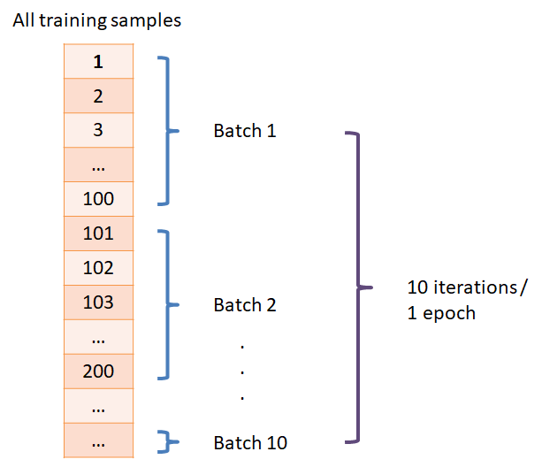
Number of Epochs

Slide 14
Activation Functions (Neuron)
It determine the functions applied to the outputs of each neuron to introduce non-linearity.
Common activation functions include
ReLU (Rectified Linear Unit),
Softmax

Slide 15
Let Move to Playground

